Slide 1
Investing in Health Systems: Insights into How Health Financing Shape Workforce Density and UHC Outcomes

Slide 2
Background
Evidence from the World Health Organization (WHO) demonstrates that a minimum density of 44.5 doctors, nurses, and midwives per 10,000 population.
This rate is essential to deliver essential health services and sustain progress toward Universal Health Coverage (UHC) (World Health Organization, 2025).
Countries that reach or surpass this threshold consistently record service coverage indices above 70%, reflecting improved access, quality, and equity in care (Ahmat, Asamani, & Illou, 2022).

Slide 3
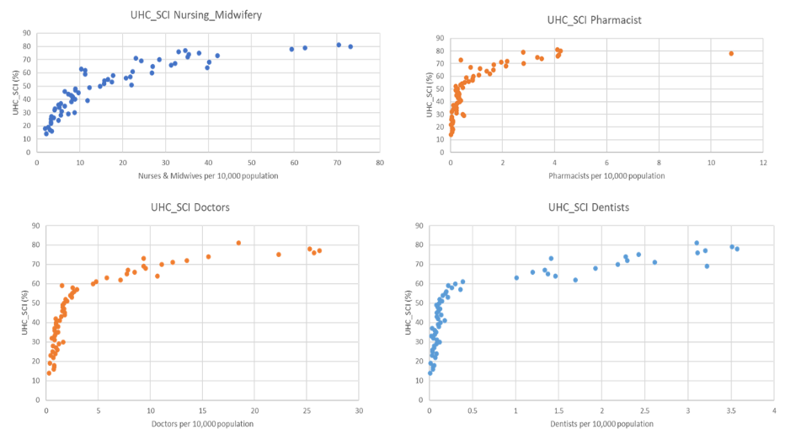
Average Number of Health Workers vis-à-vis UHC_SCI
To determine the minimum average proportion of health workers (doctors, nurses, midwives, dentists, and pharmacists) per 10,000 population required to meet the 70% UHC.
A descriptive analysis of data from 47 WHO African regional countries spanning from 2000 to 2024 was conducted.
It was discovered that on average, we need 11.09 doctors, 2.19 dentists, 28.53 nurses or midwives, and 2.81 pharmacists per 10,000 population to achieve 70% universal health coverage.

Slide 4
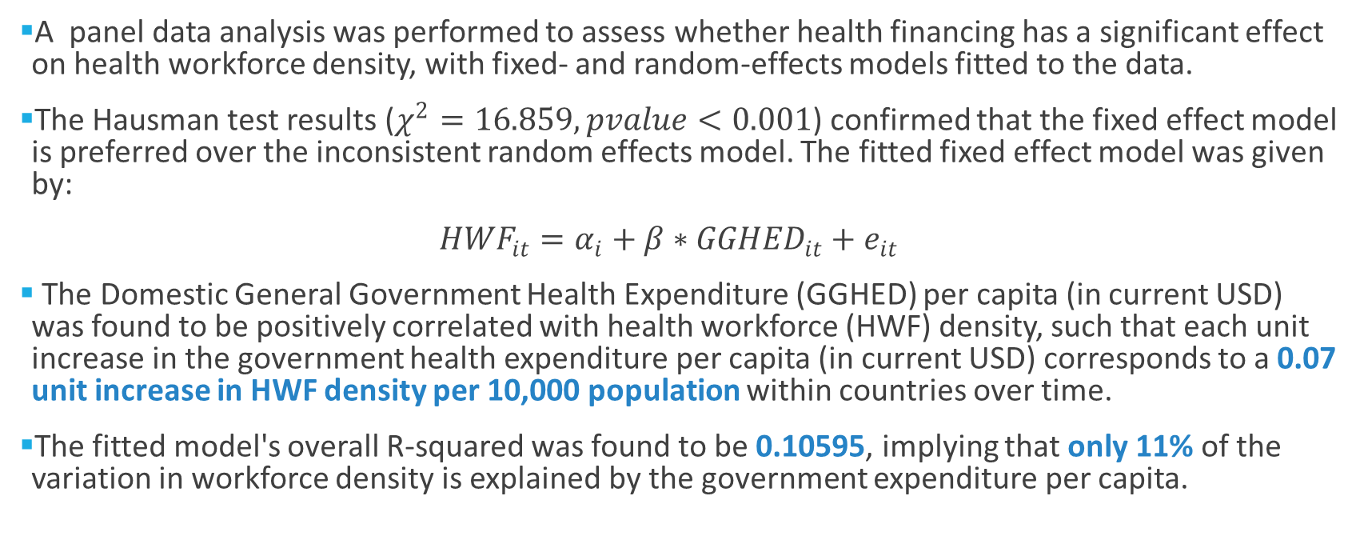
Effect of Government Health Financing on Health Workforce Densities
A panel data analysis was performed to assess whether health financing has a significant effect on health workforce density, with fixed- and random-effects models fitted to the data.
The Hausman test results ($χ^{2}=16.859, pvalue<0.001$) confirmed that the fixed effect model is preferred over the inconsistent random effects model. The fitted fixed effect model was given by:
${HWF}_{it}=α_{i}+{β∗GGHED}_{it}+e_{it}$
The Domestic General Government Health Expenditure (GGHED) per capita (in current USD) was found to be positively correlated with health workforce (HWF) density, such that each unit increase in the government health expenditure per capita (in current USD) corresponds to a 0.07 unit increase in HWF density per 10,000 population within countries over time.
The fitted model's overall R-squared was found to be 0.10595, implying that only 11% of the variation in workforce density is explained by the government expenditure per capita.

Slide 5
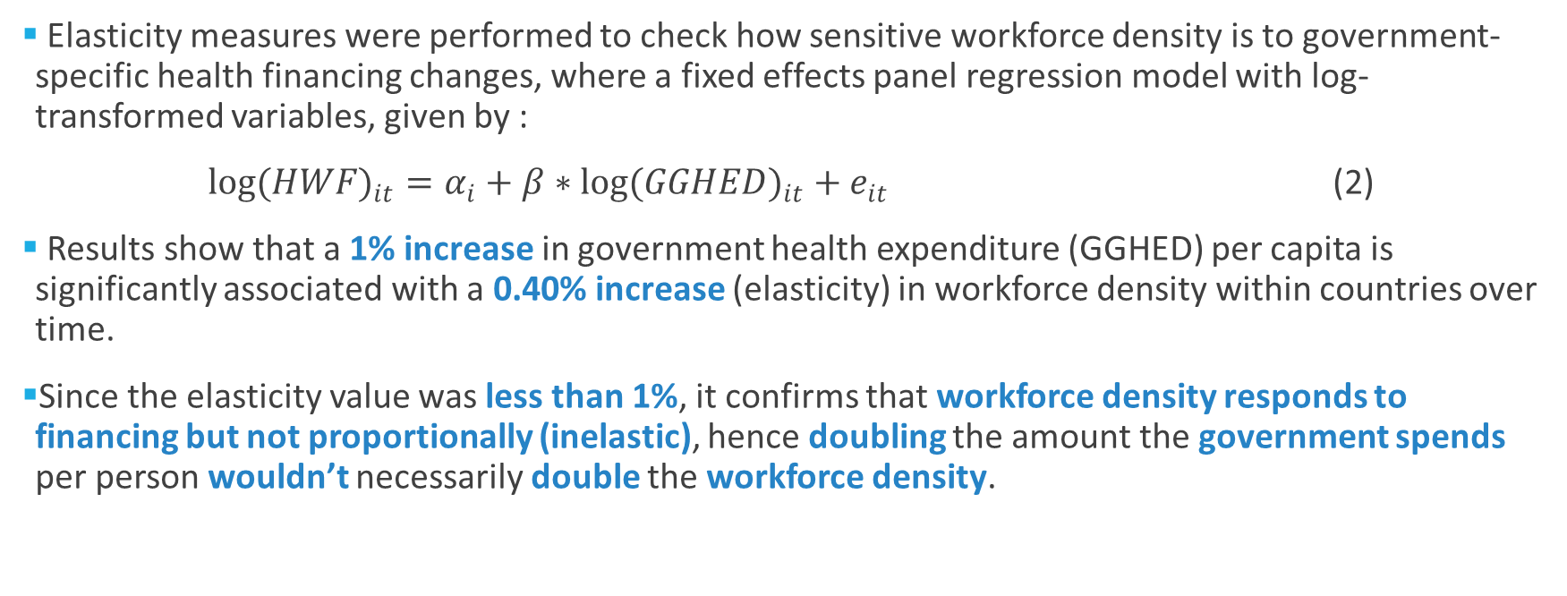
Sensitivity of Workforce Density to Government-Specific Health Financing Changes
Elasticity measures were performed to check how sensitive workforce density is to government-specific health financing changes, where a fixed effects panel regression model with log-transformed variables, given by :
$log({HWF)}_{it}=α_{i}+{β∗log(GGHED)}_{it}+e_{it}$ (2)
Results show that a 1% increase in government health expenditure (GGHED) per capita is significantly associated with a 0.40% increase (elasticity) in workforce density within countries over time.
Since the elasticity value was less than 1%, it confirms that workforce density responds to financing but not proportionally (inelastic), hence doubling the amount the government spends per person wouldn’t necessarily double the workforce density.

Slide 6
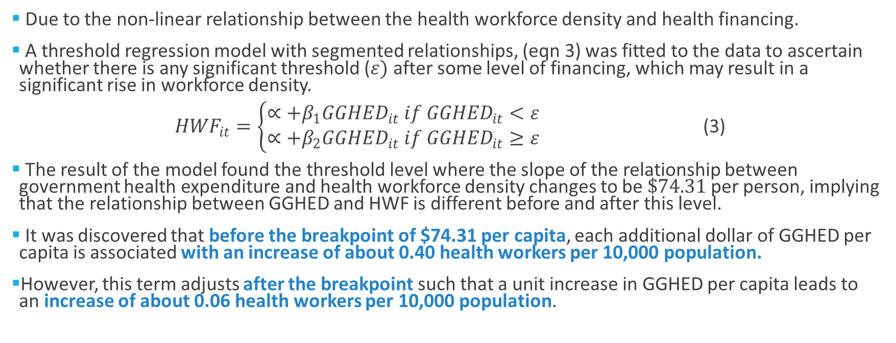
Sensitivity of Workforce Density to Government-Specific Health Financing Changes Contd…
Due to the non-linear relationship between the health workforce density and health financing.
A threshold regression model with segmented relationships, (eqn 3) was fitted to the data to ascertain whether there is any significant threshold ($ε)$ after some level of financing, which may result in a significant rise in workforce density.
${HWF}_{it}=\left\{\begin{aligned}∝+β_{1}{GGHED}_{it} if {GGHED}_{it}<ε \\ ∝+β_{2}{GGHED}_{it} if {GGHED}_{it}≥ε \end{aligned}\right.$ (3)
The result of the model found the threshold level where the slope of the relationship between government health expenditure and health workforce density changes to be $\$74.31$per person, implying that the relationship between GGHED and HWF is different before and after this level.
It was discovered that before the breakpoint of $74.31 per capita, each additional dollar of GGHED per capita is associated with an increase of about 0.40 health workers per 10,000 population.
However, this term adjusts after the breakpoint such that a unit increase in GGHED per capita leads to an increase of about 0.06 health workers per 10,000 population.

Slide 7
Lagged Effect of Government-Specific Health Financing on Workforce Density
A lagged fixed-effect model was fitted to the data to help us capture any delayed effects government health expenditure may have on health workforce density.
The results show that government spending has a small (0.0412), almost significant (pvalue=0.0709) impact on health workforce density within one year.
However, the strongest positive effect (0.1114) appears after 4 years, suggesting that health financing translates into workforce growth through other constraints such as training, retention, and so on.
Implying that government health expenditure per capita influences health workforce density both in the short term (maybe through hiring) and medium term (maybe through training and deployment).
In addition to this, an R-squared value of 0.342 was recorded, implying that 34% of the variation in workforce density within countries is explained by lagged government spending.

